Slide 1
CS4100: Computer Architecture The Processor (II)
Prof. Chung-Ta King
Department of Computer Science
National Tsing Hua University, Taiwan

Slide 2
Outline
Problem statement and logic review (Sec. 4.1, 4.2)
Building a simple RISC-V processor with datapath and control (Sec. 4.3, 4.4)
Building a pipelined RISC-V processor with datapath and control (Sec. 4.5, 4.6)
Dealing hazards in pipelined processor: data and control hazards (Sec. 4.7, 4.8)
Handling exceptions (Sec. 4.9)
More advanced topics: parallelism via instructions, ARM Cortex-A53 and Intel Core i7 Pipelines, instruction-level parallelism (Sec. 4.10, 4.11, 4.12)

Slide 3
Pipelining Is Natural!
Laundry example:
Ann, Brian, Cathy, Dave each have one load of clothes to wash, dry, and fold
Washer takes 30 minutes
Dryer takes 40 minutes
“Folder” takes 20 minutes
A
B
C
D

Slide 4
Sequential Laundry
Sequential laundry takes 6 hours for 4 loads
If they learned pipelining, how long would it take?
6 PM
7
8
9
10
11
Midnight
Time
30
40
20
30
40
20
30
40
20
30
40
20
T
a
s
k
O
r
d
e
r
A
B
C
D

Slide 5
Pipelined Laundry: Start ASAP
Pipelined laundry takes 3.5 hours for 4 loads
Speedup = 8/3.5 = 2.3
6 PM
7
8
9
10
11
Midnight
Time
30
40
40
40
40
20
T
a
s
k
O
r
d
e
r
A
B
C
D

Slide 6
Pipelining Lessons
Multiple tasks working at same time using different resources
Doesn’t help latency of single task, but throughput of entire
Pipeline rate limited by slowest stage
→ balance stage length
Ideal speedup = # of stages
kN / (k+(N–1)): for k stages
Time to “fill” & “drain” the pipeline reduce speedup
6 PM
7
8
9
Time
30
40
40
40
40
20
T
a
s
k
O
r
d
e
r
A
B
C
D

Slide 7
Why Pipeline? Because Resources Are There!
Time (clock cycles)
Single-cycle Datapath
Inst 0
Im
Reg
ALU
Dm
Reg
I
n
s
t
r.
O
r
d
e
r
Inst 1
Im
Reg
ALU
Dm
Reg
Inst 2
Im
Reg
ALU
Dm
Reg
Inst 3
Im
Reg
ALU
Dm
Reg
Inst 4
Im
Reg
ALU
Dm
Reg

Slide 8
RISC-V Pipeline
Five stages, one step per stage
IF: Instruction fetch from memory
ID: Instruction decode and register read
EX: Execute operation or calculate address
MEM: Access memory operand
WB: Write result back to register
IF
ID
EX
MEM
WB
Im
Reg
ALU
Dm
Reg

Slide 9
Single-Cycle vs. Pipeline
Single-cycle implementation:
Pipeline implementation:
Cycle 1
Cycle 2
Clk
ld
sd
Waste
Cycle 1
Cycle 2
Cycle 3
Cycle 4
Cycle 5
Cycle 6
Cycle 7
Cycle 8
Cycle 9
Cycle 10
Clk
ld
IF
ID
EX
MEM
WB
sd
IF
ID
EX
MEM
WB
R-type
IF
ID
EX
MEM
WB
Notes:
Here are the timing diagrams showing the differences between the single cycle, multiple cycle, and pipeline implementations.
For example, in the pipeline implementation, we can finish executing the Load, Store, and R-type instruction sequence in seven cycles.
In the multiple clock cycle implementation, however, we cannot start executing the store until Cycle 6 because we must wait for the load instruction to complete.
Similarly, we cannot start the execution of the R-type instruction until the store instruction has completed its execution in Cycle 9.
In the Single Cycle implementation, the cycle time is set to accommodate the longest instruction, the Load instruction.
Consequently, the cycle time for the Single Cycle implementation can be five times longer than the multiple cycle implementation.
But may be more importantly, since the cycle time has to be long enough for the load instruction, it is too long for the store instruction so the last part of the cycle here is wasted.
+2 = 77 min. (X:57)

Slide 10
Pipeline Performance
Assume time for stages is
100ps for register read or write
200ps for other stages
Compare pipelined with single-cycle datapath
Fig. 4.24
Instr | IF | ID | EX | MEM | WB | Total time
ld | 200ps | 100 ps | 200ps | 200ps | 100 ps | 800ps
sd | 200ps | 100 ps | 200ps | 200ps |  | 700ps
R-type | 200ps | 100 ps | 200ps |  | 100 ps | 600ps
beq | 200ps | 100 ps | 200ps |  |  | 500ps

Slide 11
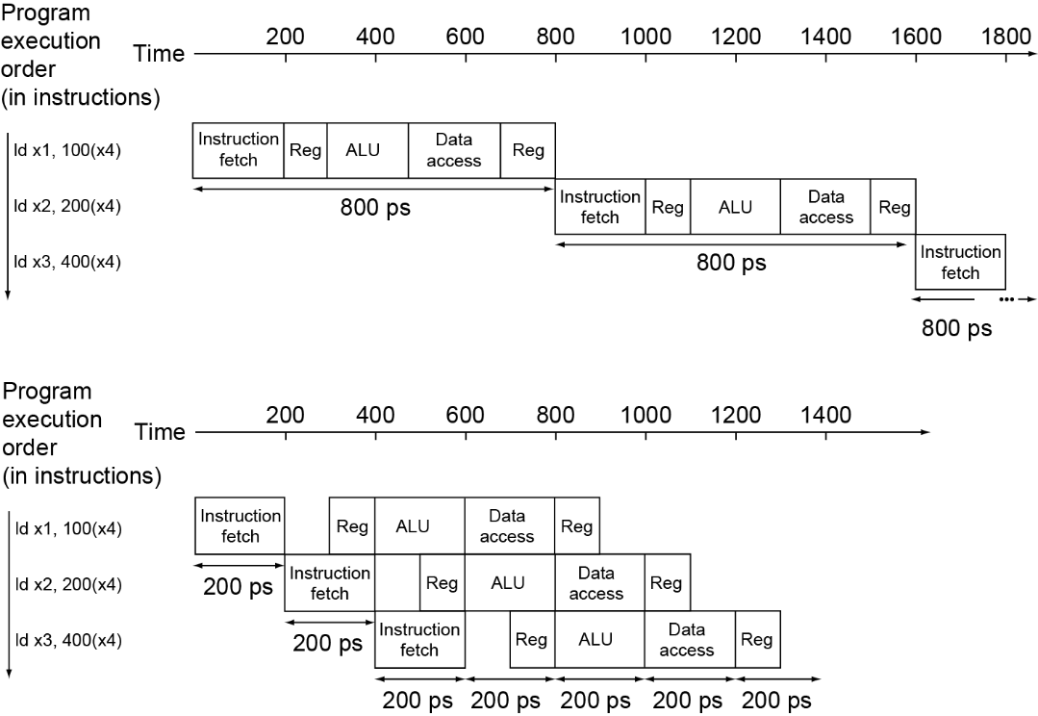
Pipeline Performance
Single-cycle (T_{c}= 800ps)
3 instructions take 2400 ps
Pipelined (T_{c}= 200ps)
3 instructions take 1200 ps
Fig. 4.25

Slide 12
Pipeline Speedup
If all stages are balanced,
i.e., all take the same time
Time between instructions_{pipelined} = Time between instructions_{nonpipelined} = 800 ps = 160 ps
Number of stages 5
Speedup for N ld instructions = N * 800 ps ≅ 5 (when N is large) 800 ps + (N-1)*160 ps
If not balanced (as in previous slide), speedup is less
(N * 800) / (800 + (N-1)*200) ≅ 4
Speedup of pipeline is due to increased throughput
Latency (time for each instruction) does not decrease

Slide 13
Design a Pipelined RISC-V Processor
RISC-V ISA designed for pipelining
All instructions are 32-bits
Easier to fetch and decode in one cycle
c.f. x86: 1- to 17-byte instructions
Few and regular instruction formats
Can decode and read registers in one step
Load/store addressing
Can calculate address in 3rd stage, access memory in 4th stage

Slide 14
Design a Pipelined RISC-V Processor
Examine the datapath and control diagram
Starting with single-cycle datapath
Partition datapath into stages:
IF (instruction fetch), ID (instruction decode and register file read), EX (execution or address calculation), MEM (data memory access), WB (write back)
Associate resources with stages
Ensure that flows do not conflict, or figure out how to resolve
Assert control in appropriate stage

Slide 15
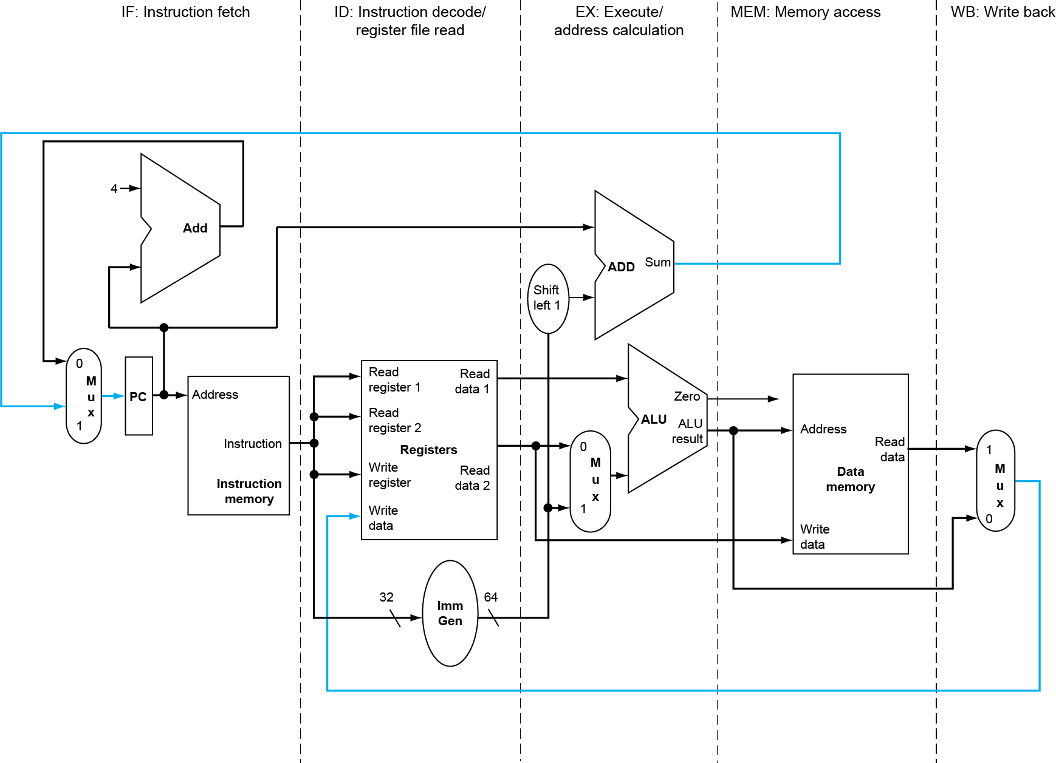
Split Single-cycle Datapath
Fig. 4.31
Feedback
Path
How to split the datapath into stages?
WB
Notes:
What to add to split the datapath into stages?

Slide 16
Recall Signal Propagation in 1-cycle Datapath
X
X
X
X
How to stop signal propagation at stage boundary?
Notes:
What to add to split the datapath into stages?

Slide 17
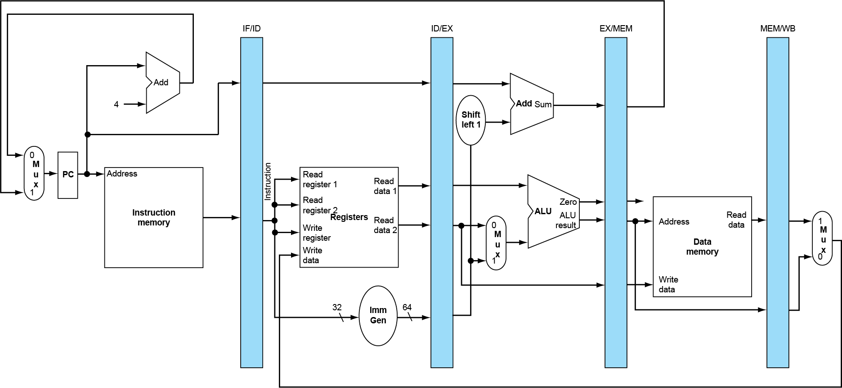
Idea: Add Registers between Stages
Pipeline registers to hold data and control signals, i.e., “state”, of an instruction
Fig. 4.33

Slide 18
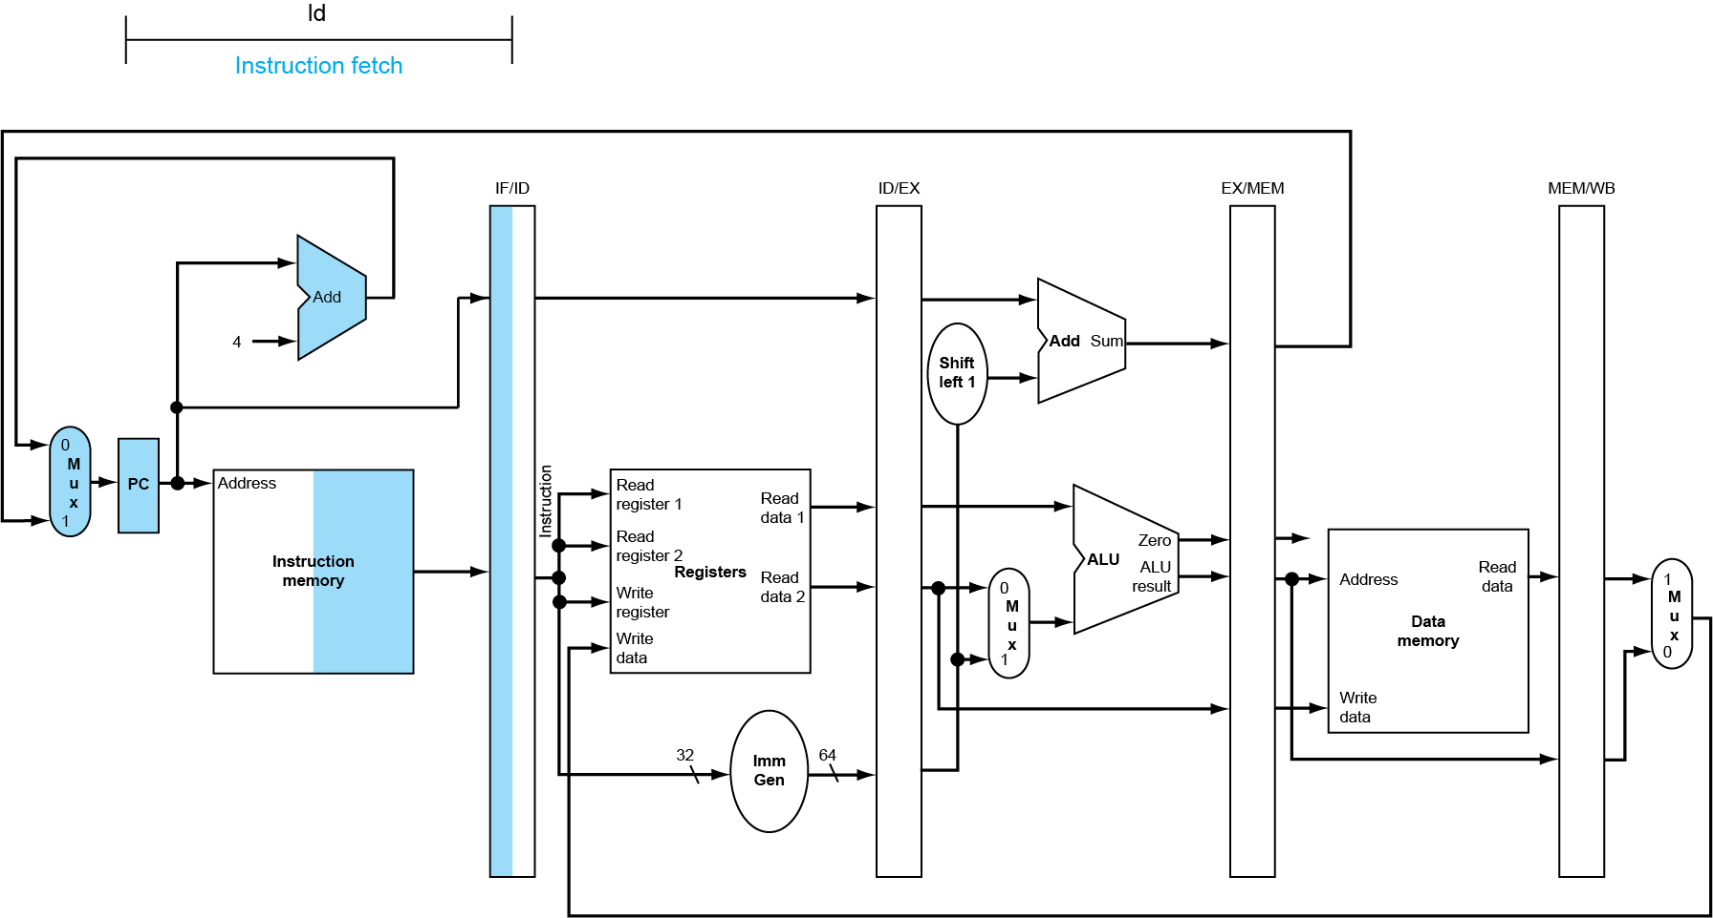
IF Stage for ld
IF/ID ← mem[PC]; IF/ID ← PC; PC ← PC + 4
immediate
rs1
funct3
rd
opcode
12 bits
5 bits
3 bits
5 bits
7 bits
Fig. 4.34
Shaded right half indicates “read”
Shaded left half indicates “write”

Slide 19
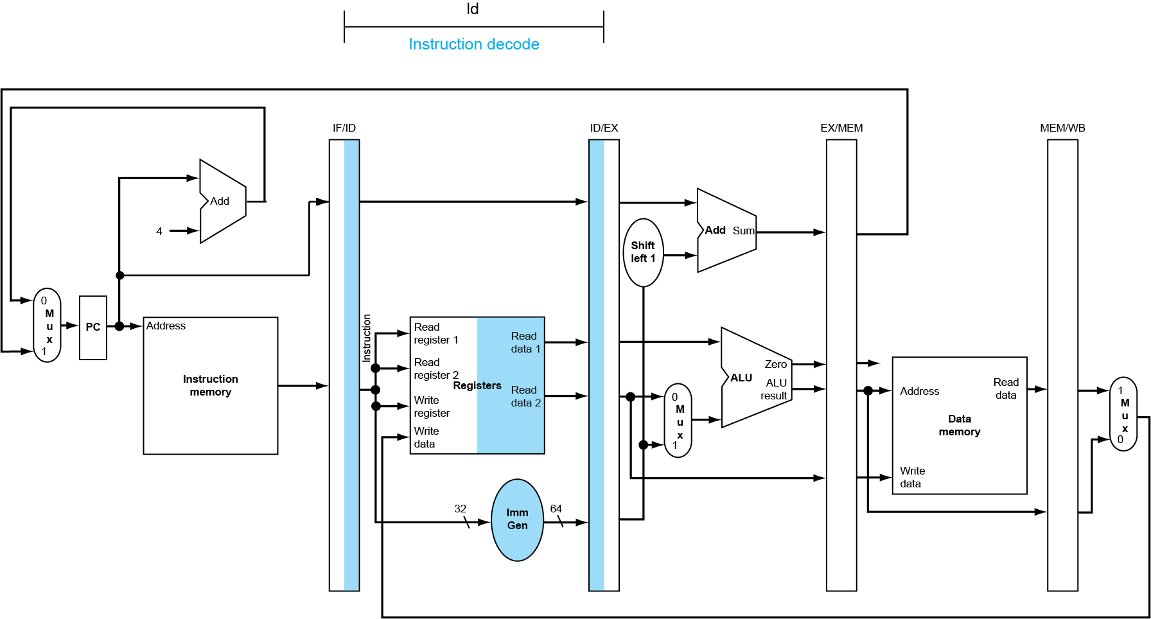
ID Stage for ld
ID/EX[A] ← Reg[IF/ID[19-15]]; ID/EX[B] ← Reg[IF/ID[24-20]]; ID/EX ← sign-ext(IF/ID[31-20]); ID/EX ← IF/ID[PC]; decode
Fig. 4.34

Slide 20
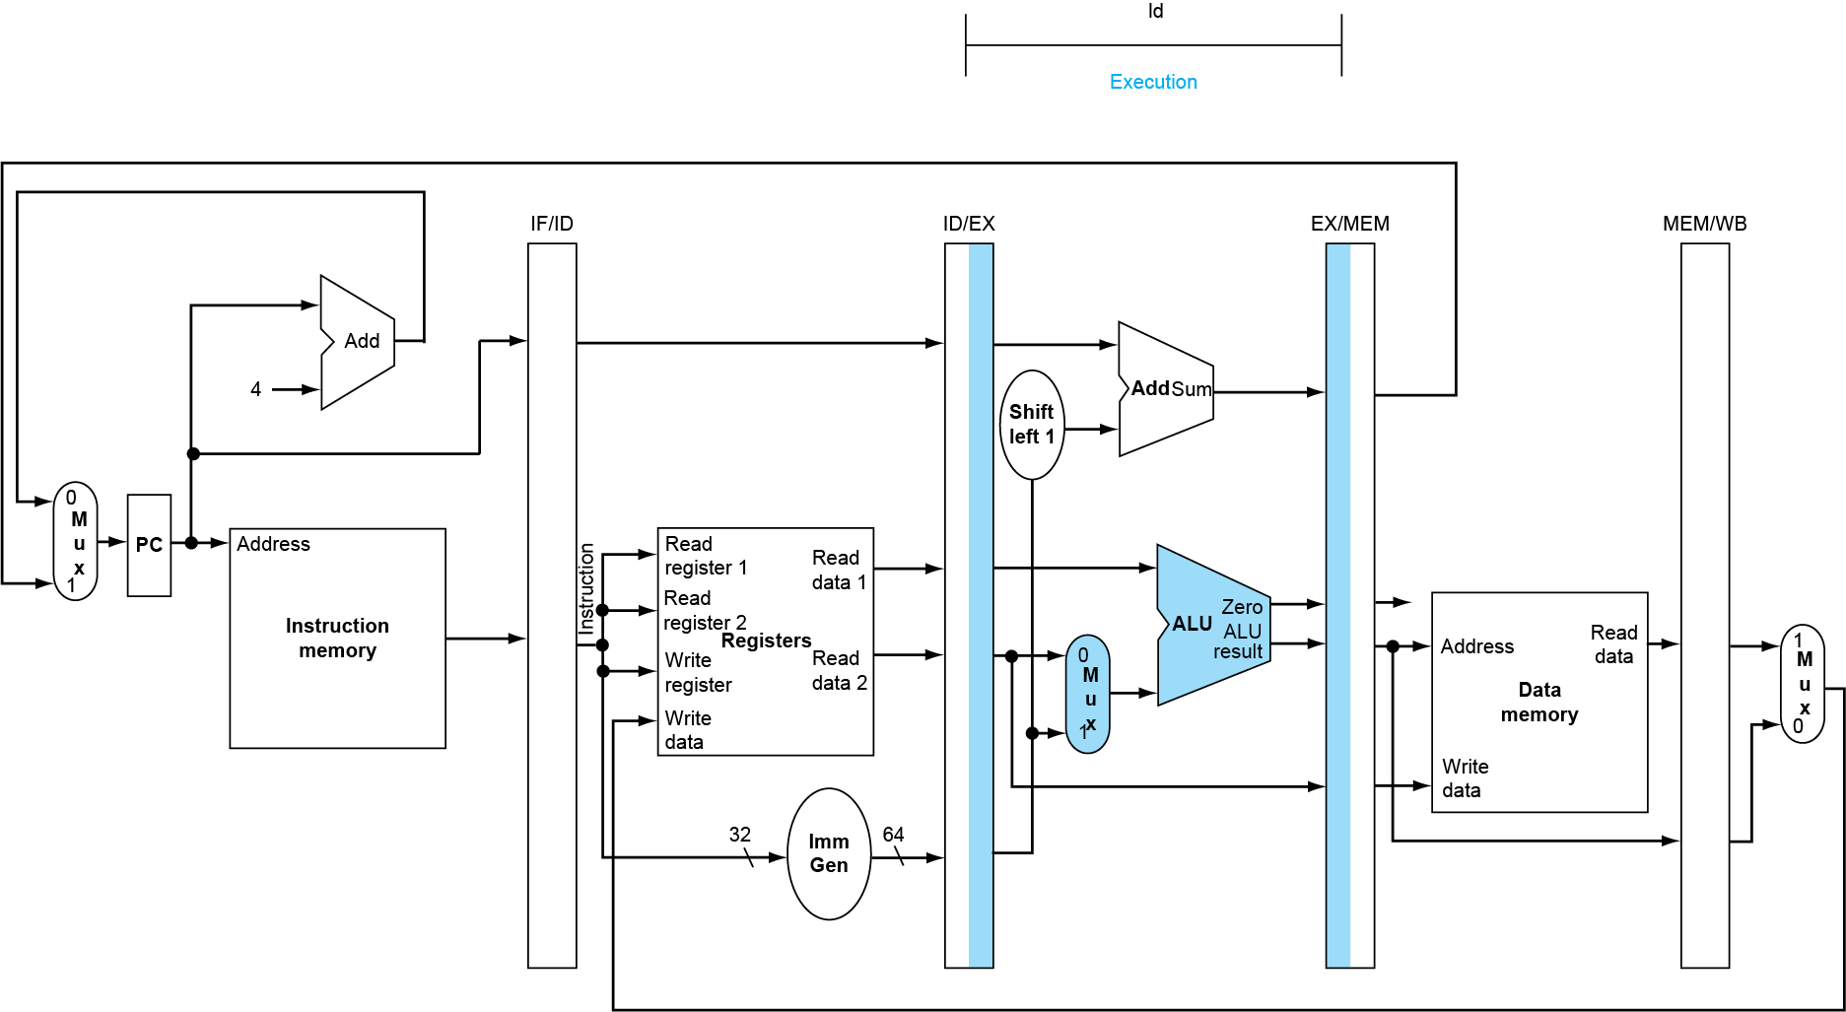
EX Stage for ld
EX/MEM[ALUout] ← ID/EX[A] + ID/EX[sign-ext]
Fig. 4.35

Slide 21
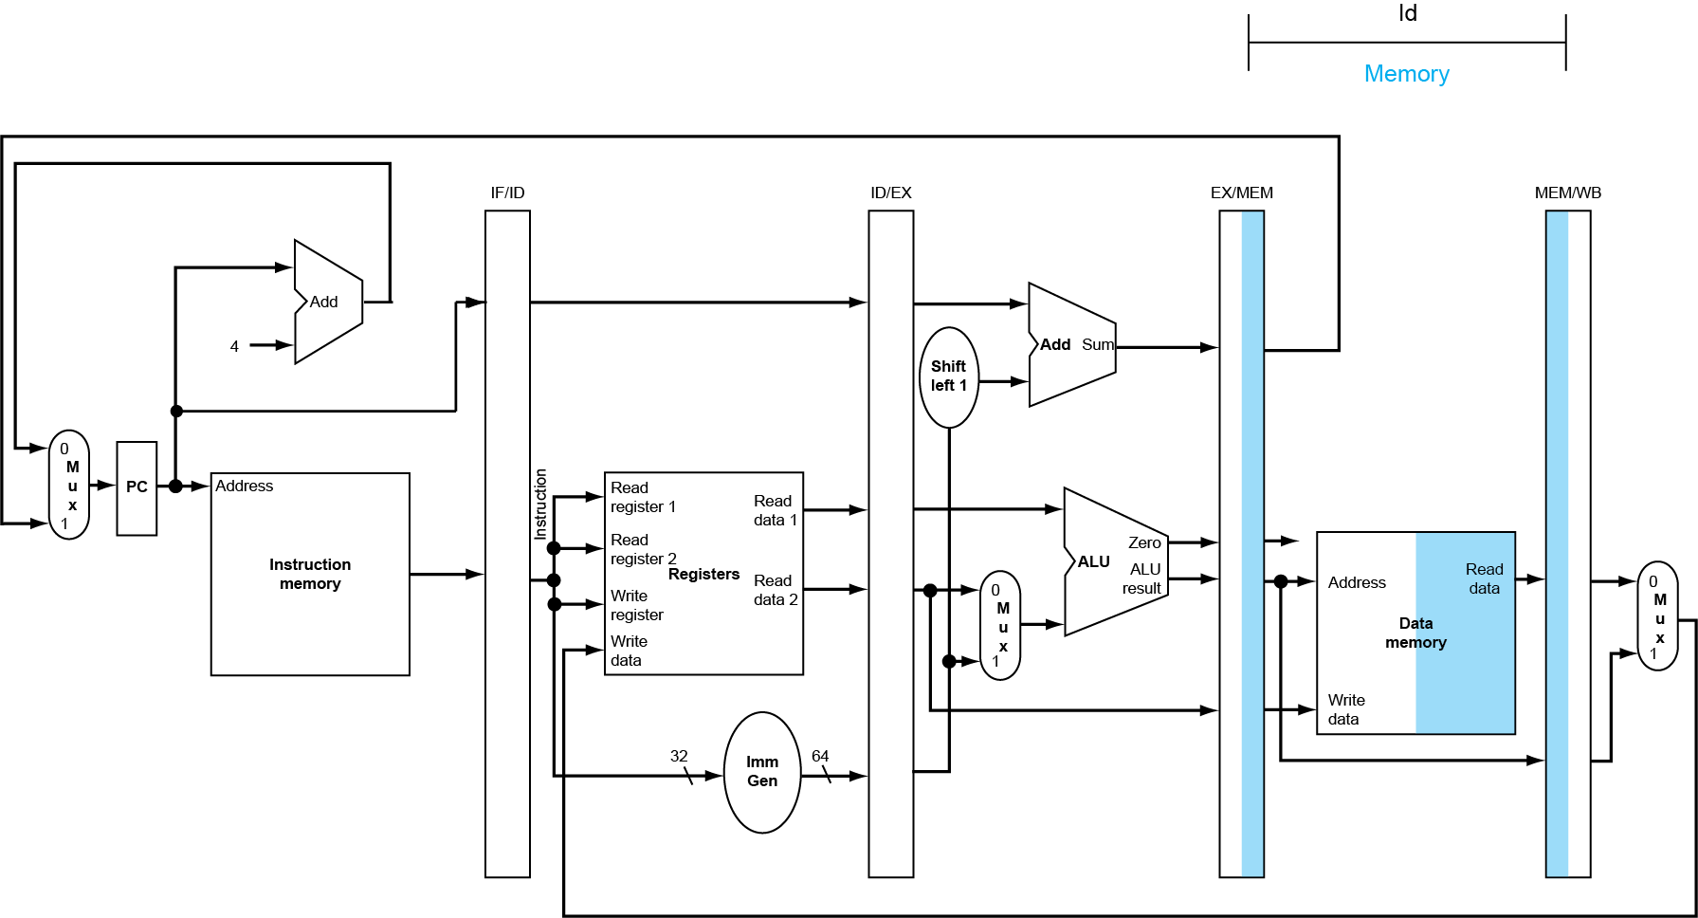
MEM Stage for ld
MEM/WB ← mem[EX/MEM[ALUout]]
Fig. 4.36

Slide 22
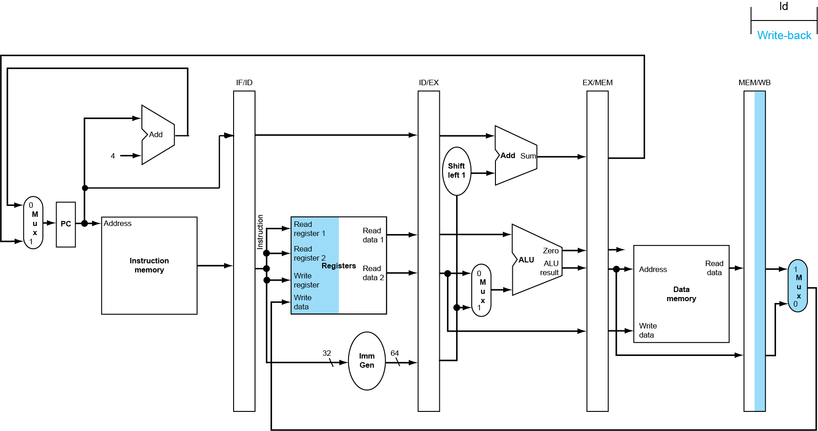
WB Stage for ld
Reg[IF/ID[11-7]] ← MEM/WB
Wrong register number
Fig. 4.36

Slide 23
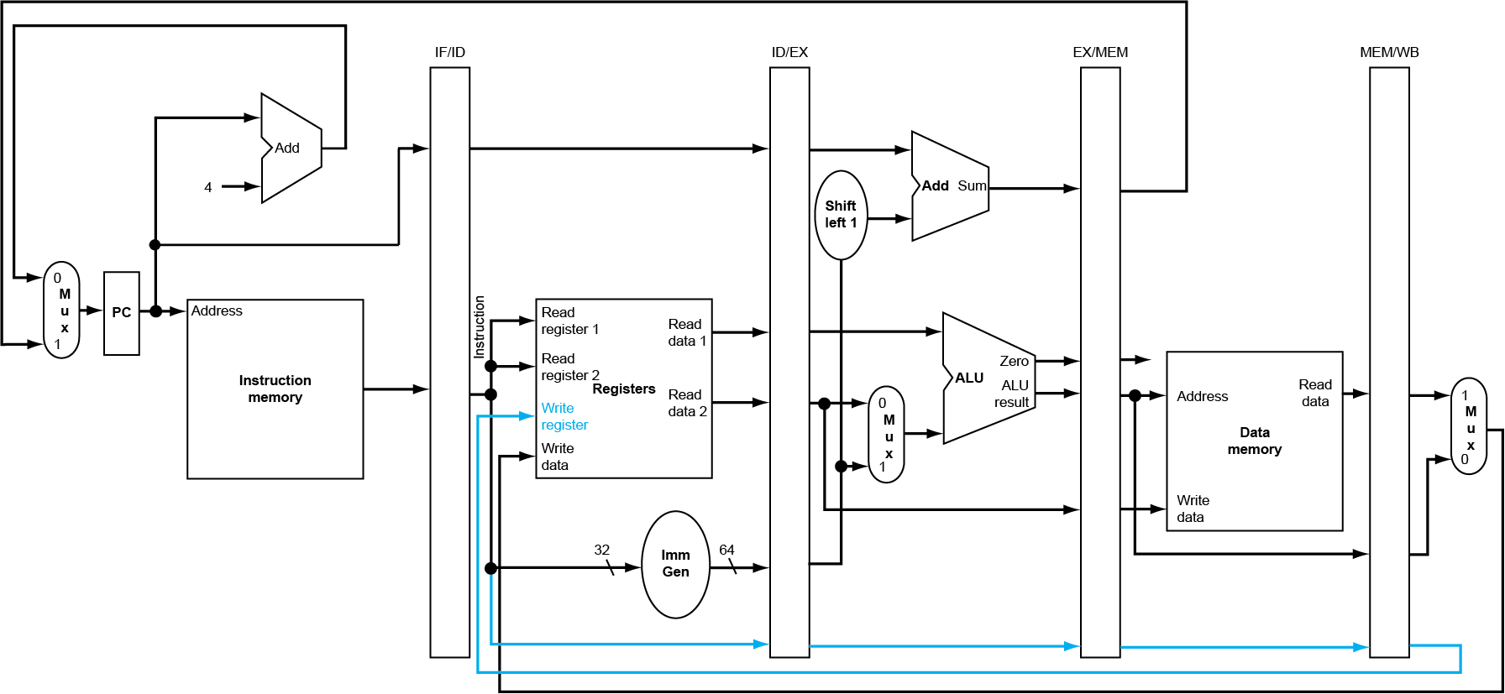
Corrected Datapath for ld
Carry rd along pipeline stages with the instruction
Fig. 4.39

Slide 24
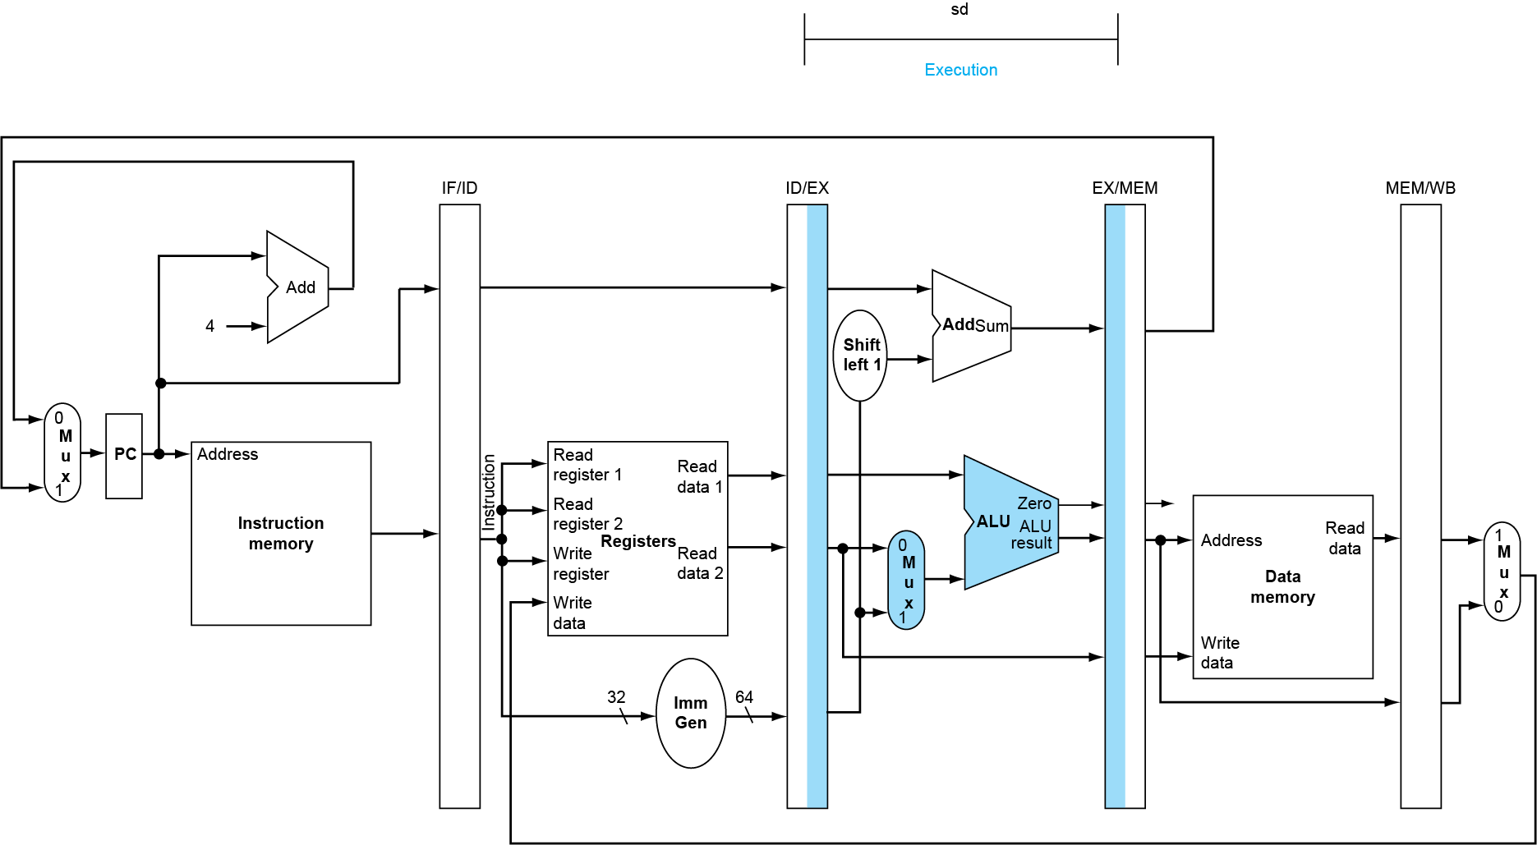
EX Stage for sd
EX/MEM[ALUout] ← ID/EX[A] + ID/EX[sign-ext] EX/MEM ← ID/EX[B]
Fig. 4.37

Slide 25
MEM Stage for sd
mem[EX/MEM[ALUout]] ← EX/MEM[B]
Fig. 4.38

Slide 26
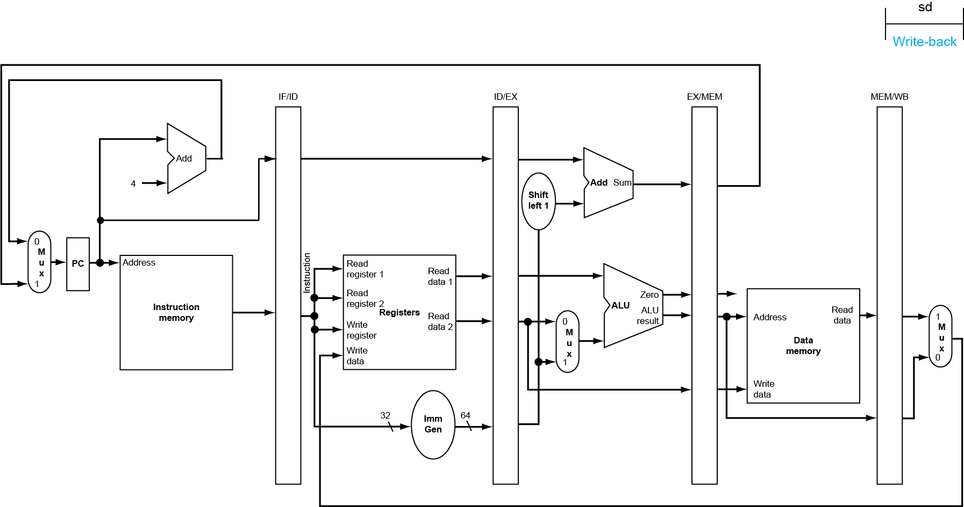
WB Stage for sd
No operation
Fig. 4.38

Slide 27
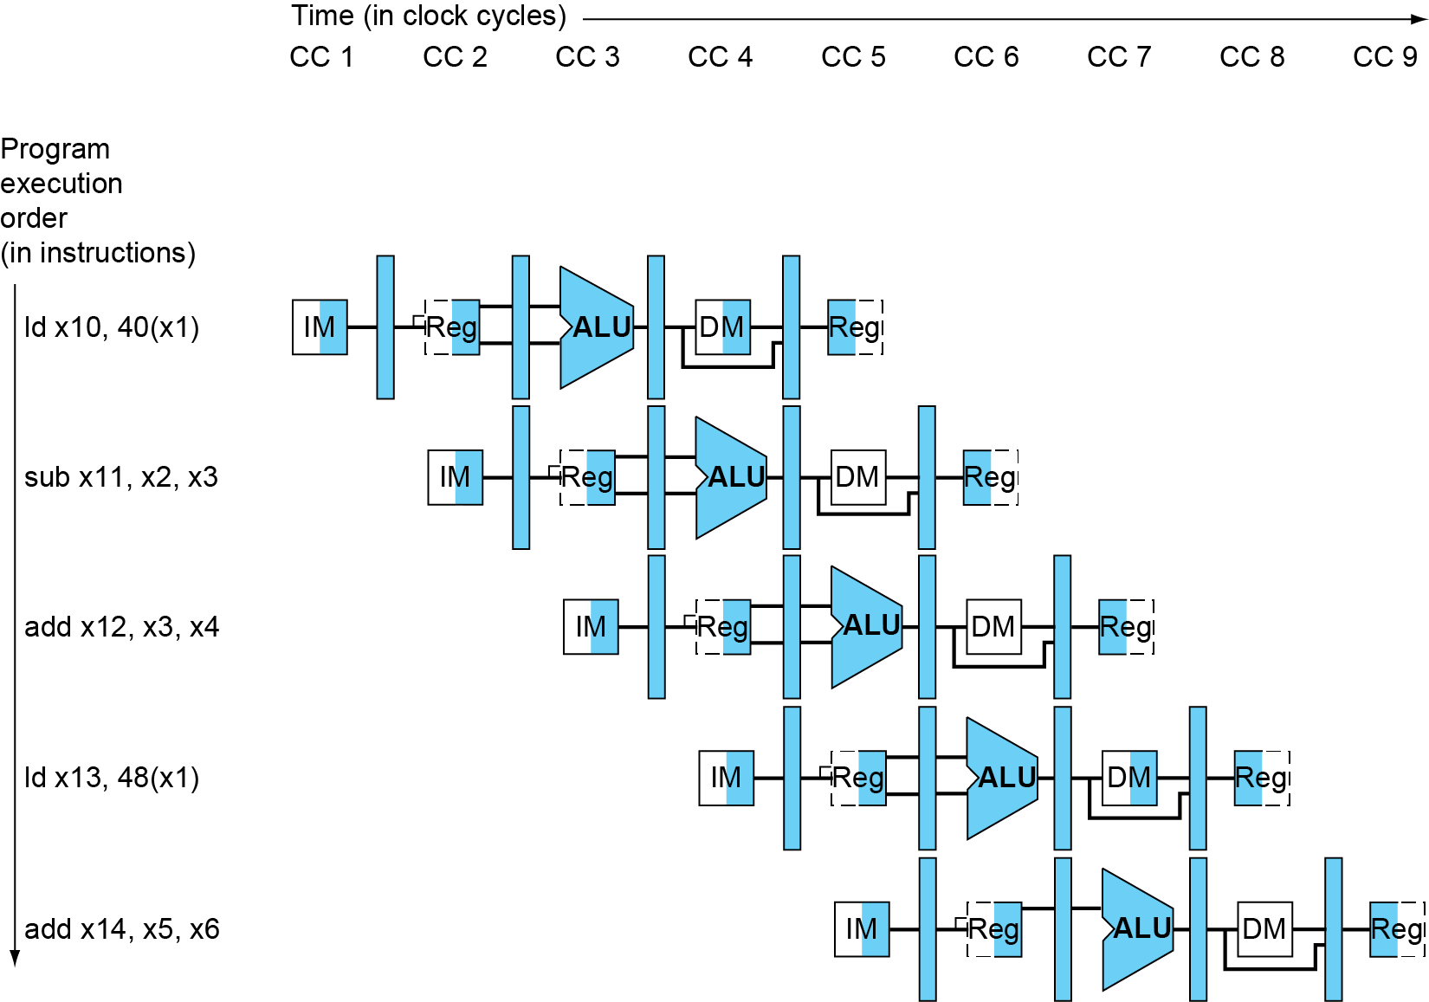
Multi-Cycle Pipeline Diagram
Form showing resource usage
Help to understand:
How many cycles to execute this code?
What is the ALU doing during cycle 4?
Fig. 4.41

Slide 28
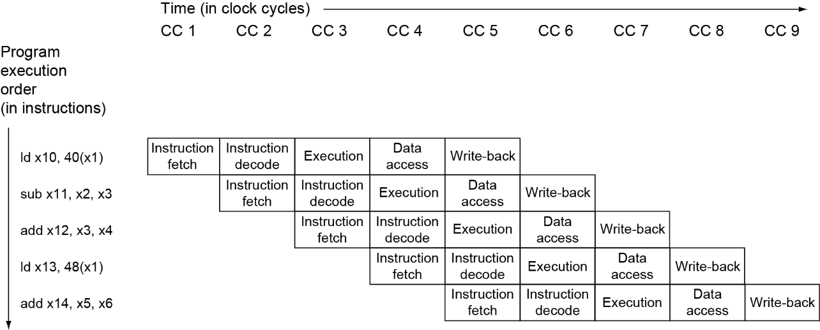
Multi-Cycle Pipeline Diagram
Traditional form
Fig. 4.42

Slide 29
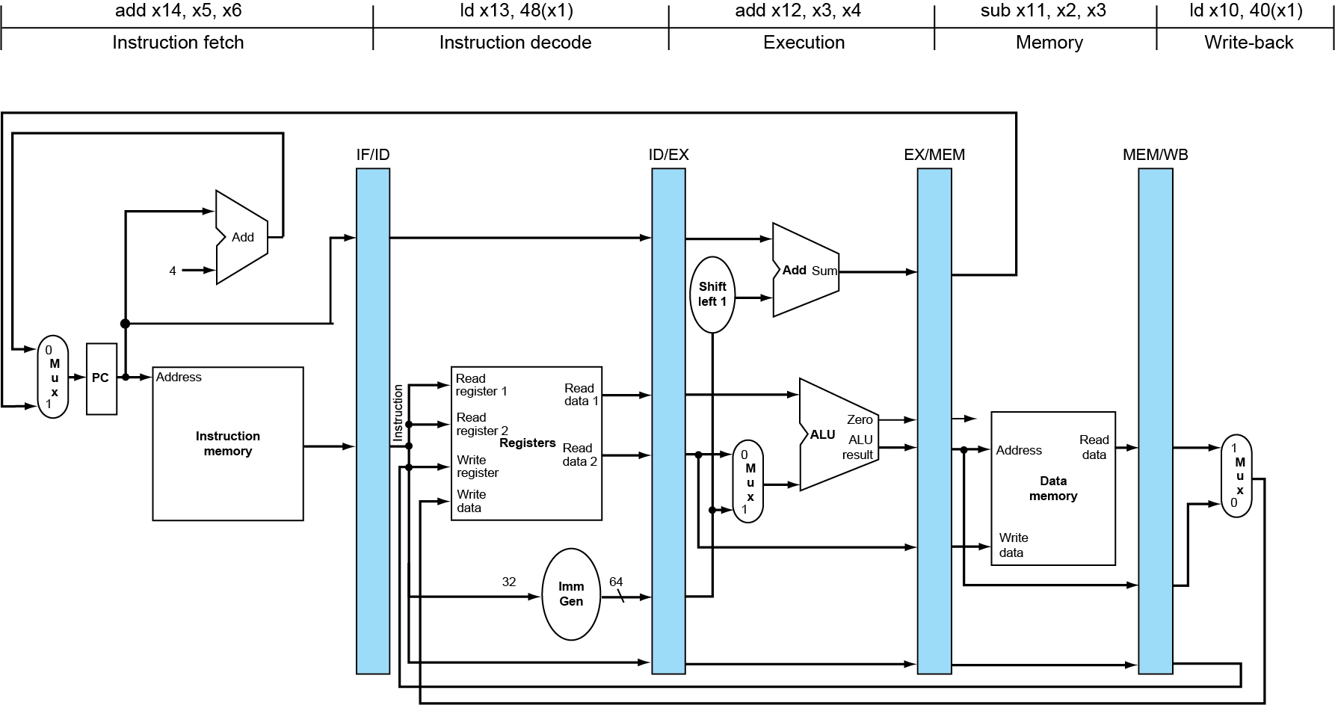
A Snapshot of the Pipeline
State of pipeline in cycle 5 of previous slide
Fig. 4.43
Notes:
The single-clock-cycle diagram corresponding to clock cycle 5 of the pipeline in Figures 4.43 and 4.44. As you can see, a single-clock-cycle figure is a vertical slice through a multiple-clock-cycle diagram.

Slide 30
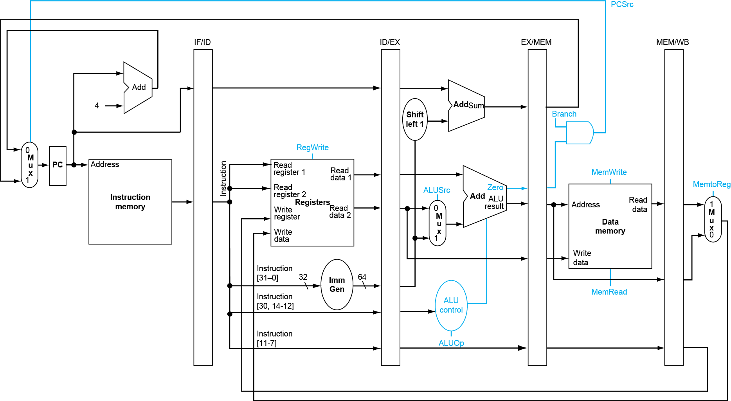
Pipelined Control: Control Signals
rd
Fig. 4.44

Slide 31
Group Signals According to Stages
Use control signals of single-cycle CPU
Note: There is no need to set PCsrc, because it is controlled by the “Branch” signal
R-type
ld
sd
beq
Fig. 4.47

Slide 32
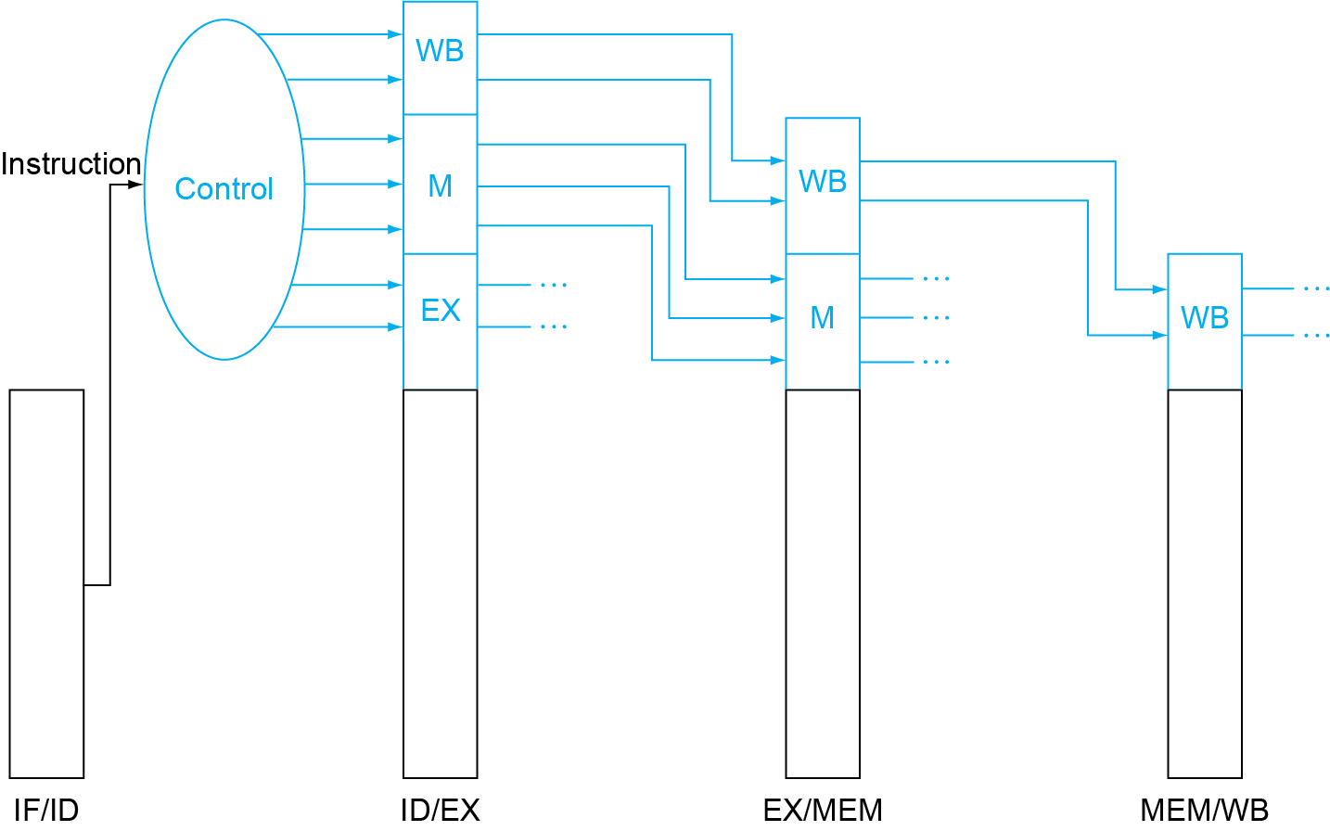
Pipelined Control
Pass control signals along pipeline registers like data
Main control generates control signals during ID
Fig. 4.48

Slide 33
Pipelined Control
Signals for EX (ALUSrc, ALUOp) are used 1 cycle later
Signals for MEM (MemRd, MemWr, Branch) are used 2 cycles later
Signals for WB (MemtoReg, RegWr) are used 3 cycles later
ID
EX
MEM
WB
ALUSrc
ALUSrc
ALUOp
ALUOp
Main
Control
MemRd
MemRd
MemRd
MemWr
MemWr
Ex/MEM Register
MEM/WB Register
IF/ID Register
ID/Ex Register
MemWr
Branch
Branch
Branch
MemtoReg
MemtoReg
MemtoReg
MemtoReg
RegWr
RegWr
RegWr
RegWr
Notes:
The main control here is identical to the one in the single cycle processor. It generate all the control signals necessary for a given instruction during that instruction Reg/Decode stage.
All these control signals will be saved in the ID/Exec pipeline register at the end of the Reg/Decode cycle.
The control signals for the Exec stage (ALUSrc, ... etc.) come from the output of the ID/Exec register. That is they are delayed ONE cycle from the cycle they are generated.
The rest of the control signals that are not used during the Exec stage is passed down the pipeline and saved in the Exec/Mem register.
The control signals for the Mem stage (MemWr, Branch) come from the output of the Exec/Mem register. That is they are delayed two cycles from the cycle they are generated.
Finally, the control signals for the Wr stage (MemtoReg & RegWr) come from the output of the Exec/Wr register: they are delayed three cycles from the cycle they are generated.
+2 = 45 min. (Y:45)

Slide 34
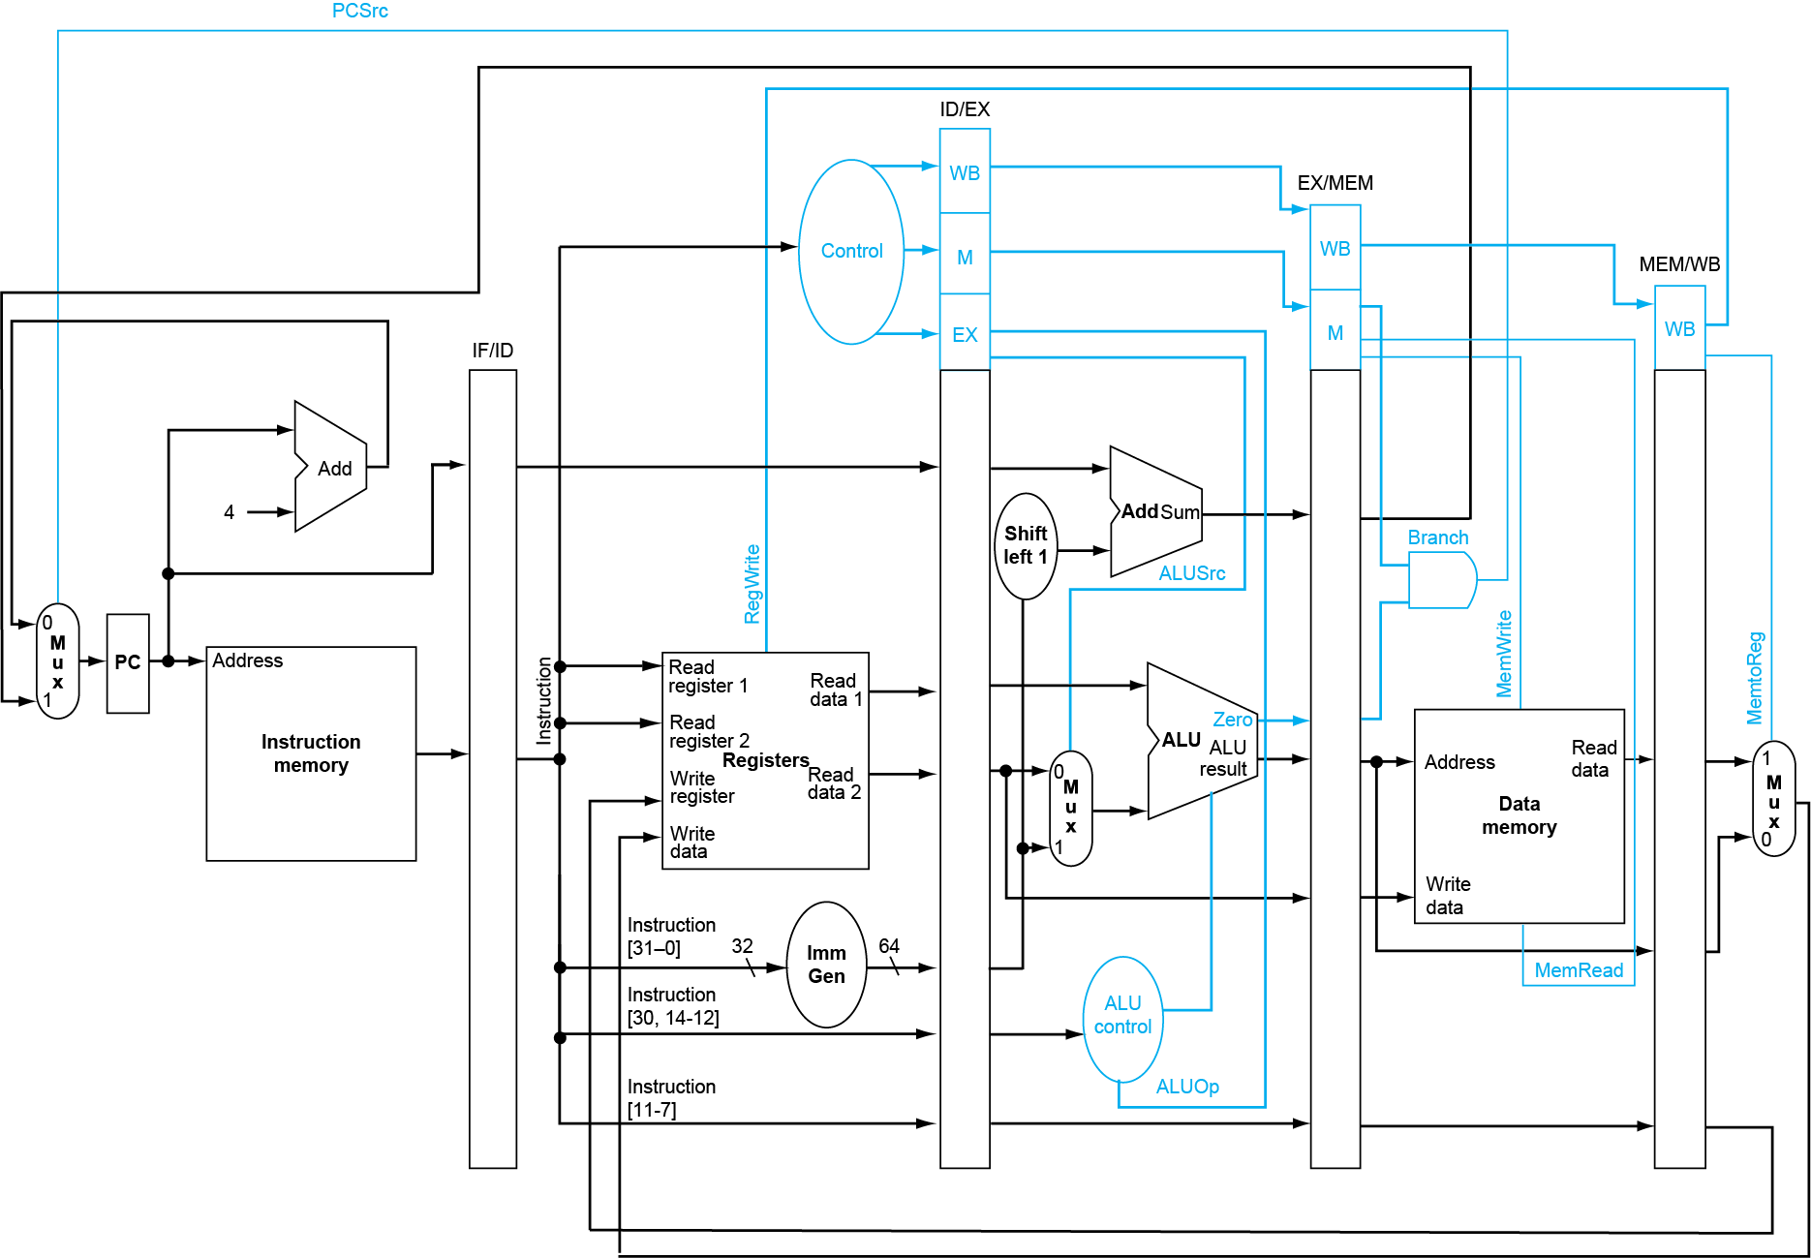
Datapath with Control
Fig. 4.49

Slide 35
Summary of Pipeline Basics
Pipelining is a fundamental concept
Multiple steps using distinct resources
Utilize capabilities of datapath by pipelined instruction processing
Start next instruction while working on the current one
Limited by length of longest stage (plus fill/flush)
CPI = ?
What makes it easy in RISC-V?
All instructions are of the same length
Just a few instruction formats
Memory operands only in loads and stores
What makes pipelining hard? hazards

